Slide 1
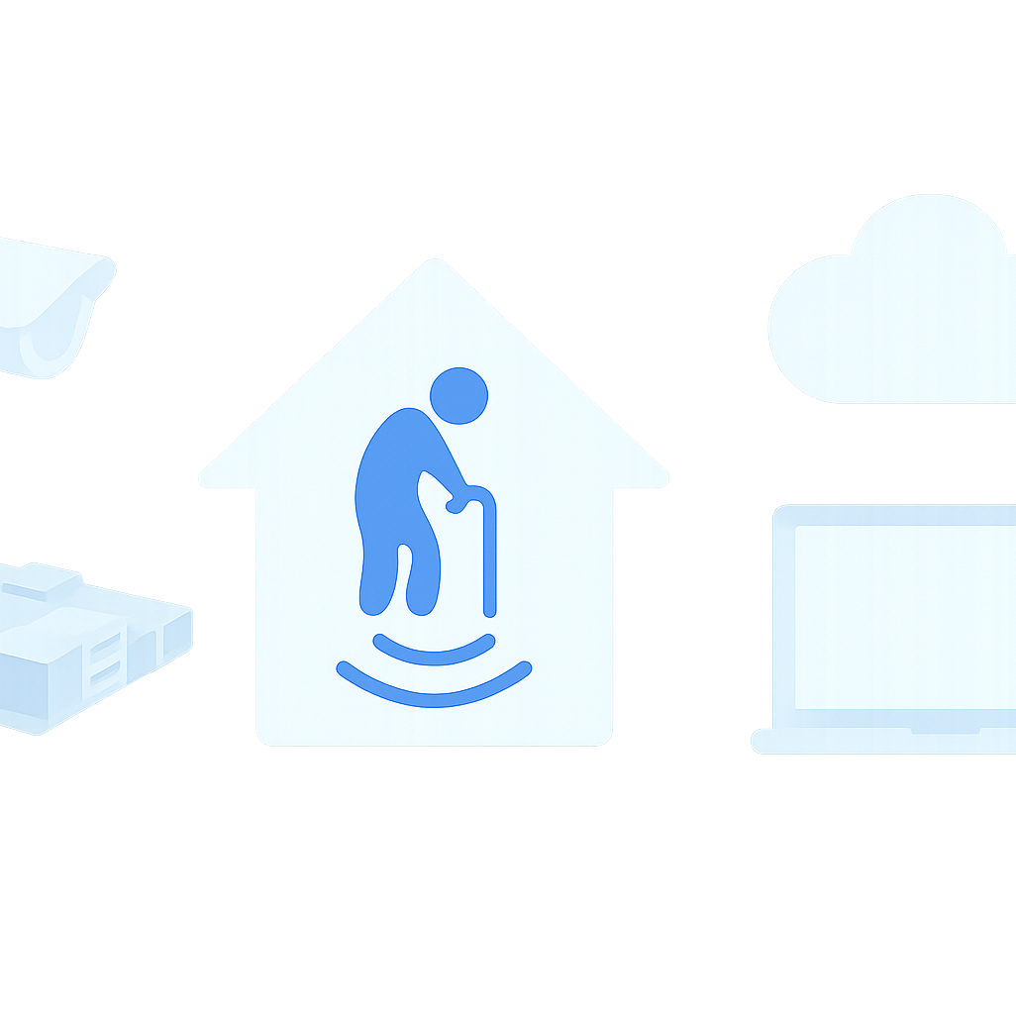
Smart Care System to Monitor in Assisted Living Environments
Team Elder Care
Matthew Thirkettle
Matthew Rooney
Harold Plant
Arpitha Banibelu Subraya

Slide 2
Overview
Smart Care System for Assisted Living
Uses motion sensors + camera + Raspberry Pi + OpenStack cloud
Goal: monitor residents safety and daily activity
Ensures independence for residents while giving peace of mind to families

Slide 3
What Have We Achieved?
We have developed a real-time patient monitoring system, by using IoT-enabled motion capture and camera-based monitoring to identify patient movements in real-time.
We believe our system enables staff to increase efficiency and quality in patient care.
Secure storage
Visualization

Slide 4
Hardware Components
Raspberry Pi
Used to collect sensor output information.
Sensors
Actuator opens the door, granting access once facial recognition conducted and security clearance ascertained.
Camera
Camera transmits footage to enable facial recognition on the VM.
Runs python scripts to connect to cloud-based infrastructure.
Utilises libraries such as OpenCV.

Slide 5
Cloud System
On OpenStack we have built a system utilising a VM
The VM also runs a database to store all the data we need to run facial recognition and any other person detection data such as pictures as well as majority of the computing we will need to unburden the raspberry pi.

Slide 6
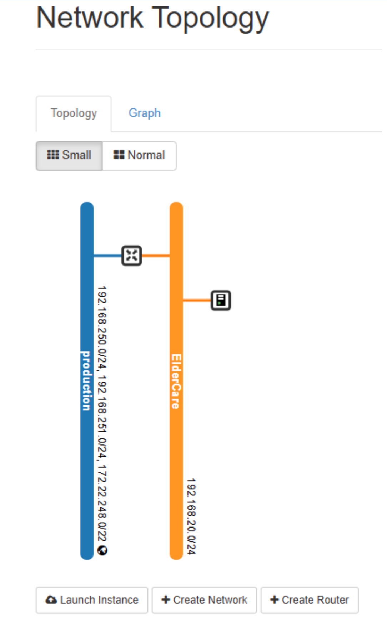
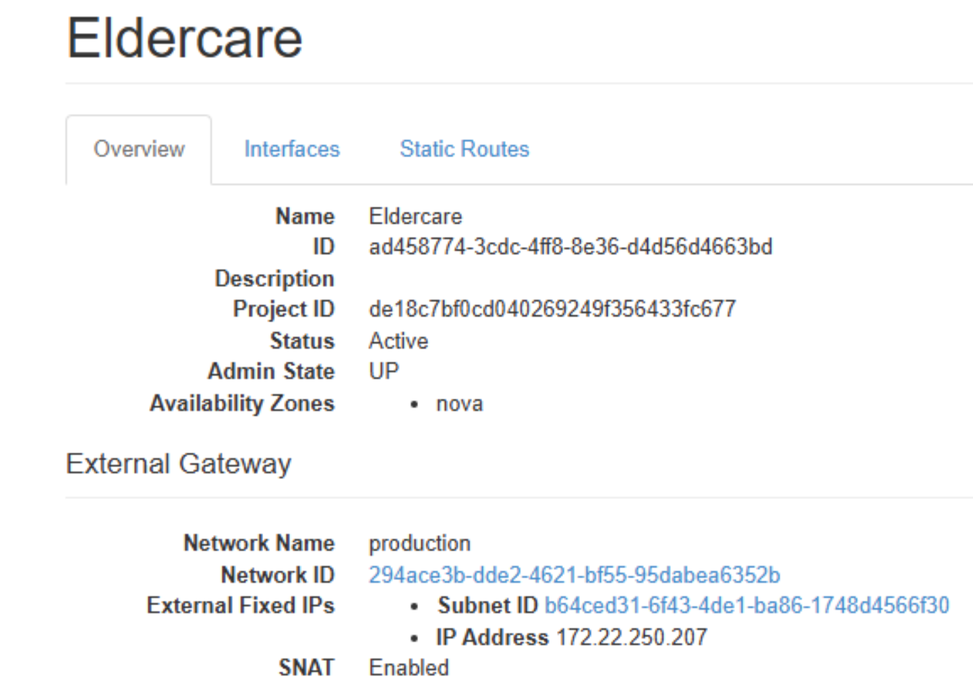
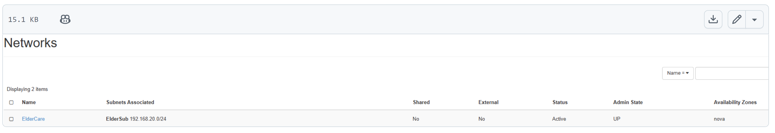
Openstack VM’s

Slide 7
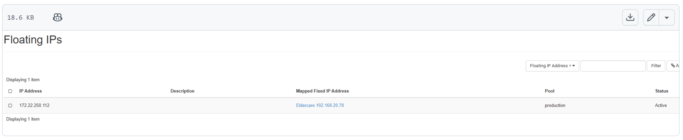
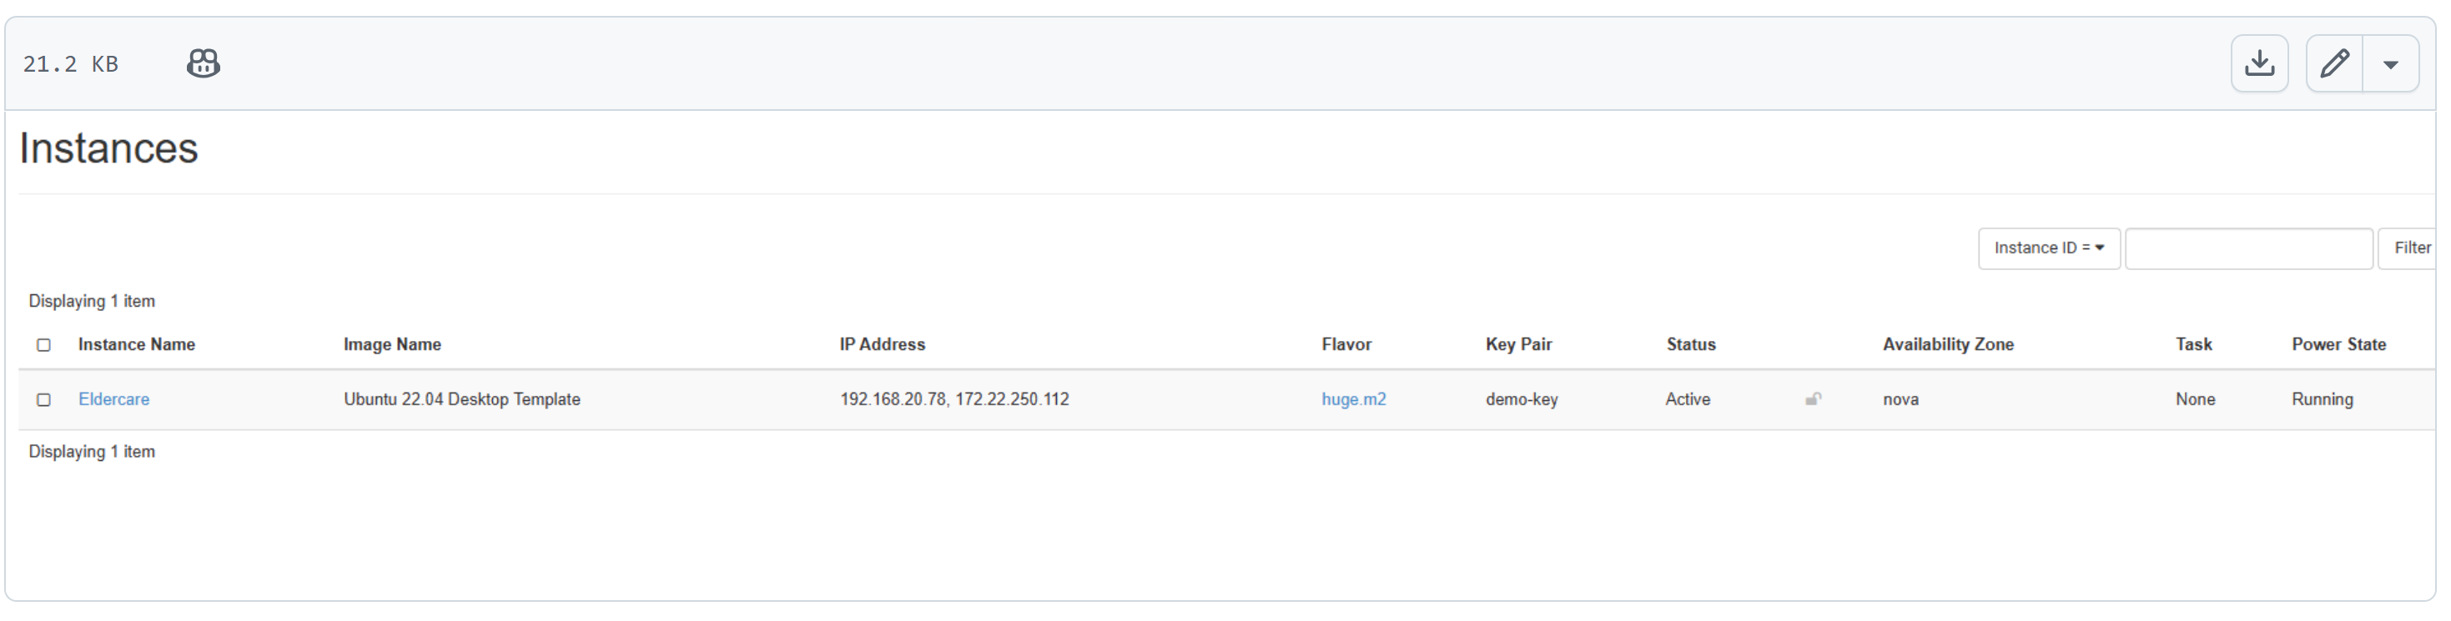
Floating IP

Slide 8
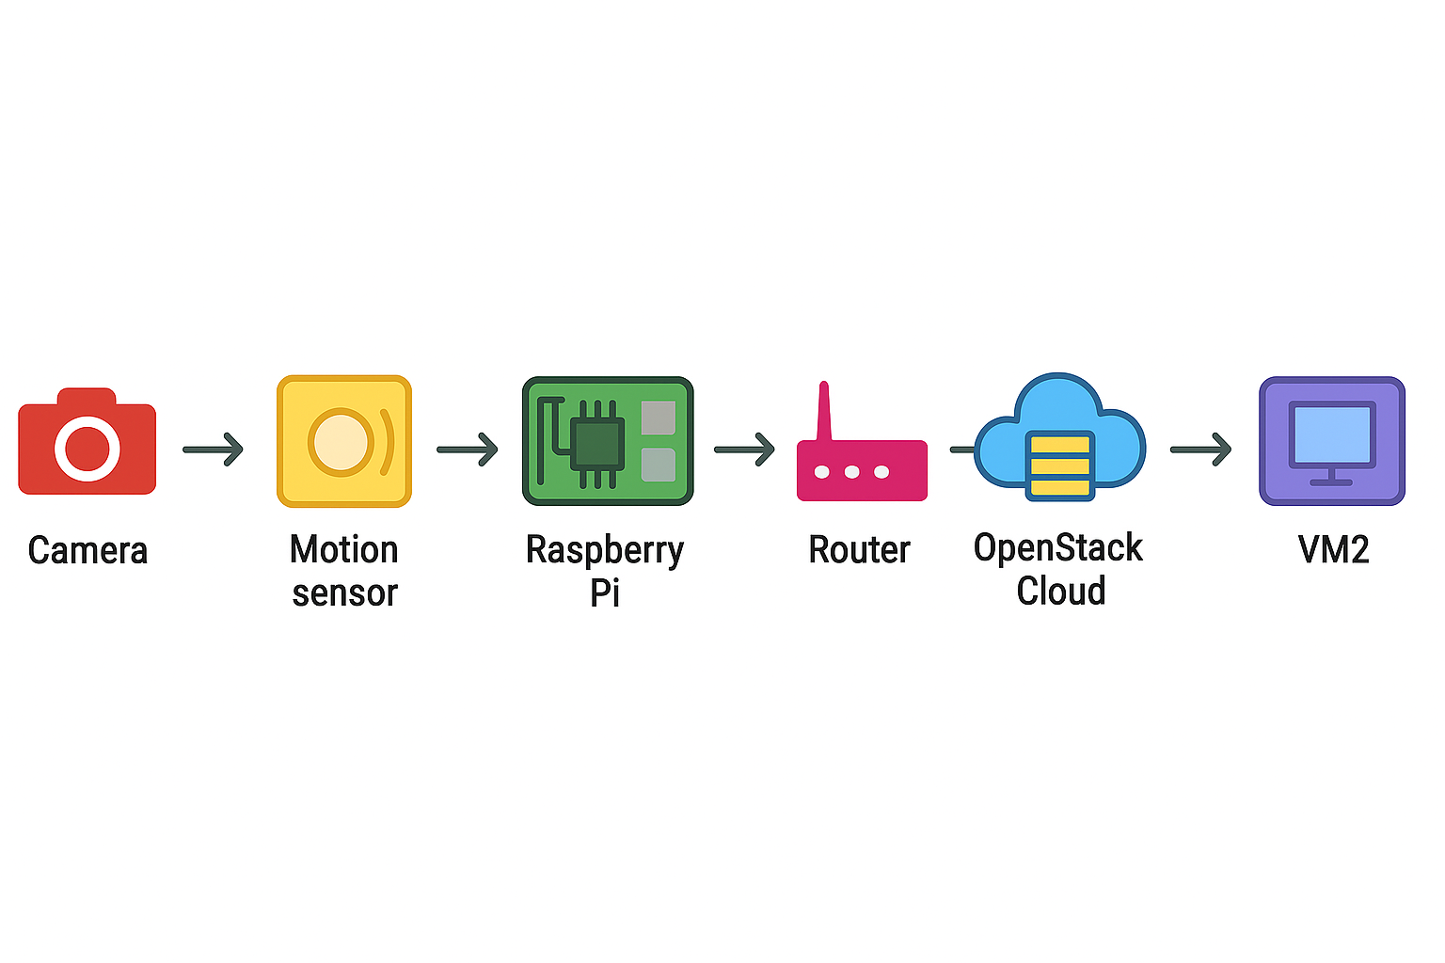
Connecting to the VM
Openstack
The VM hosted on Openstack runs python script as the server, opening the gateway for a client to connect.
Raspberry Pi
The Raspberry Pi runs python script as the client, with the known IP address of the Openstack server.

Slide 9
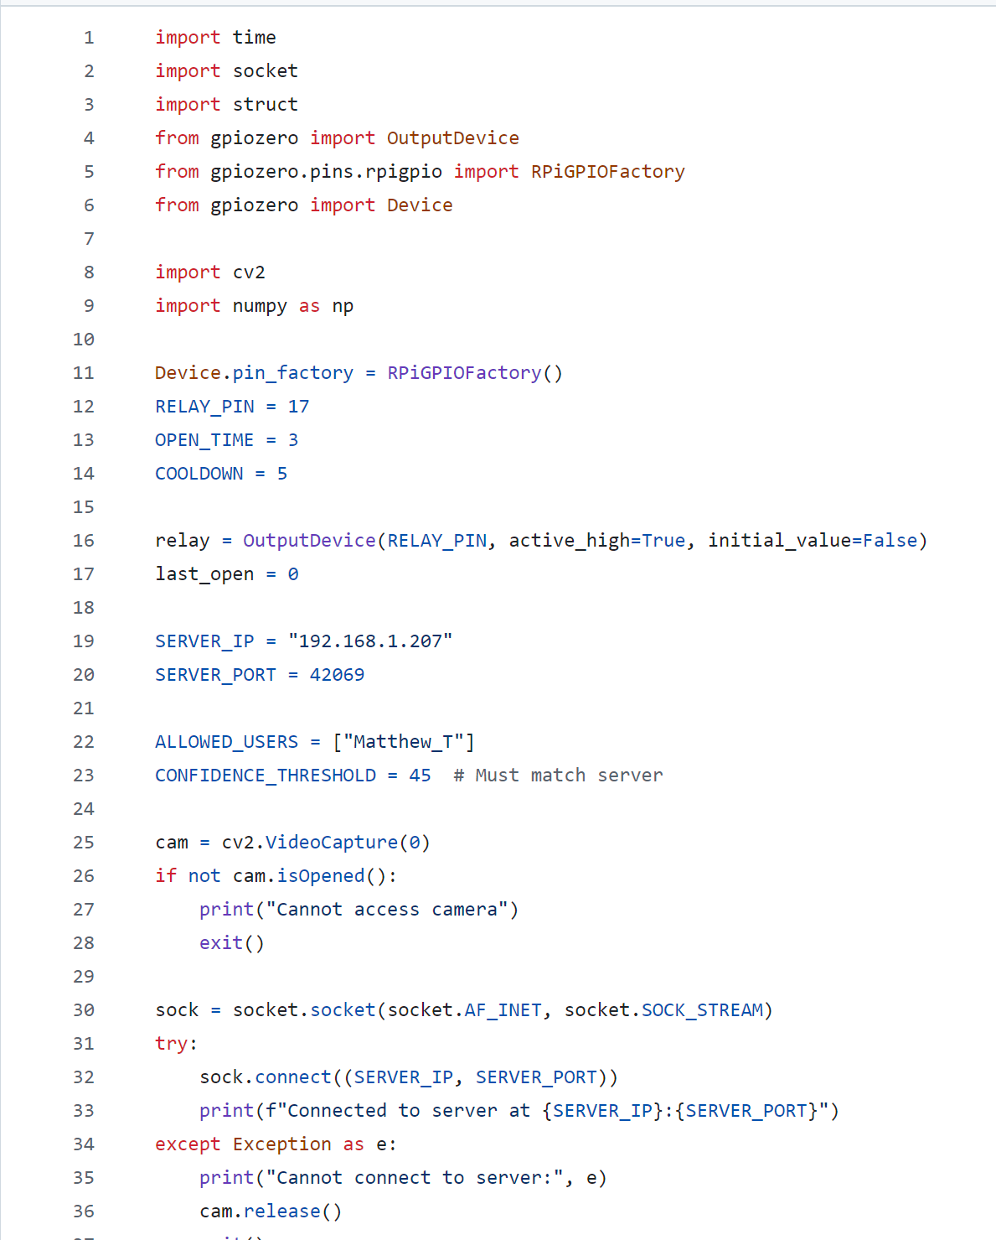
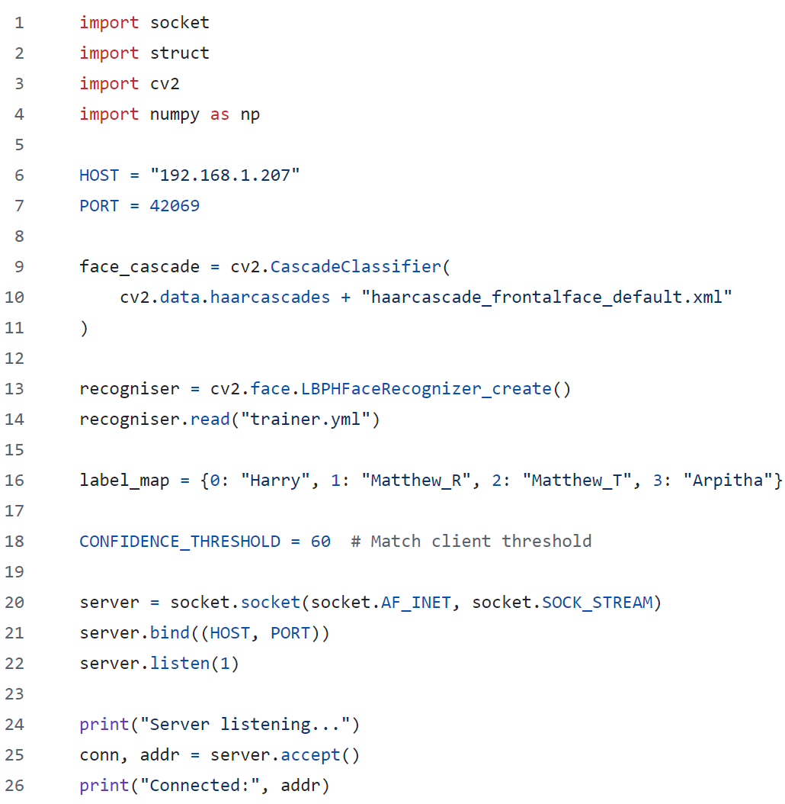
Client
Host

Slide 10
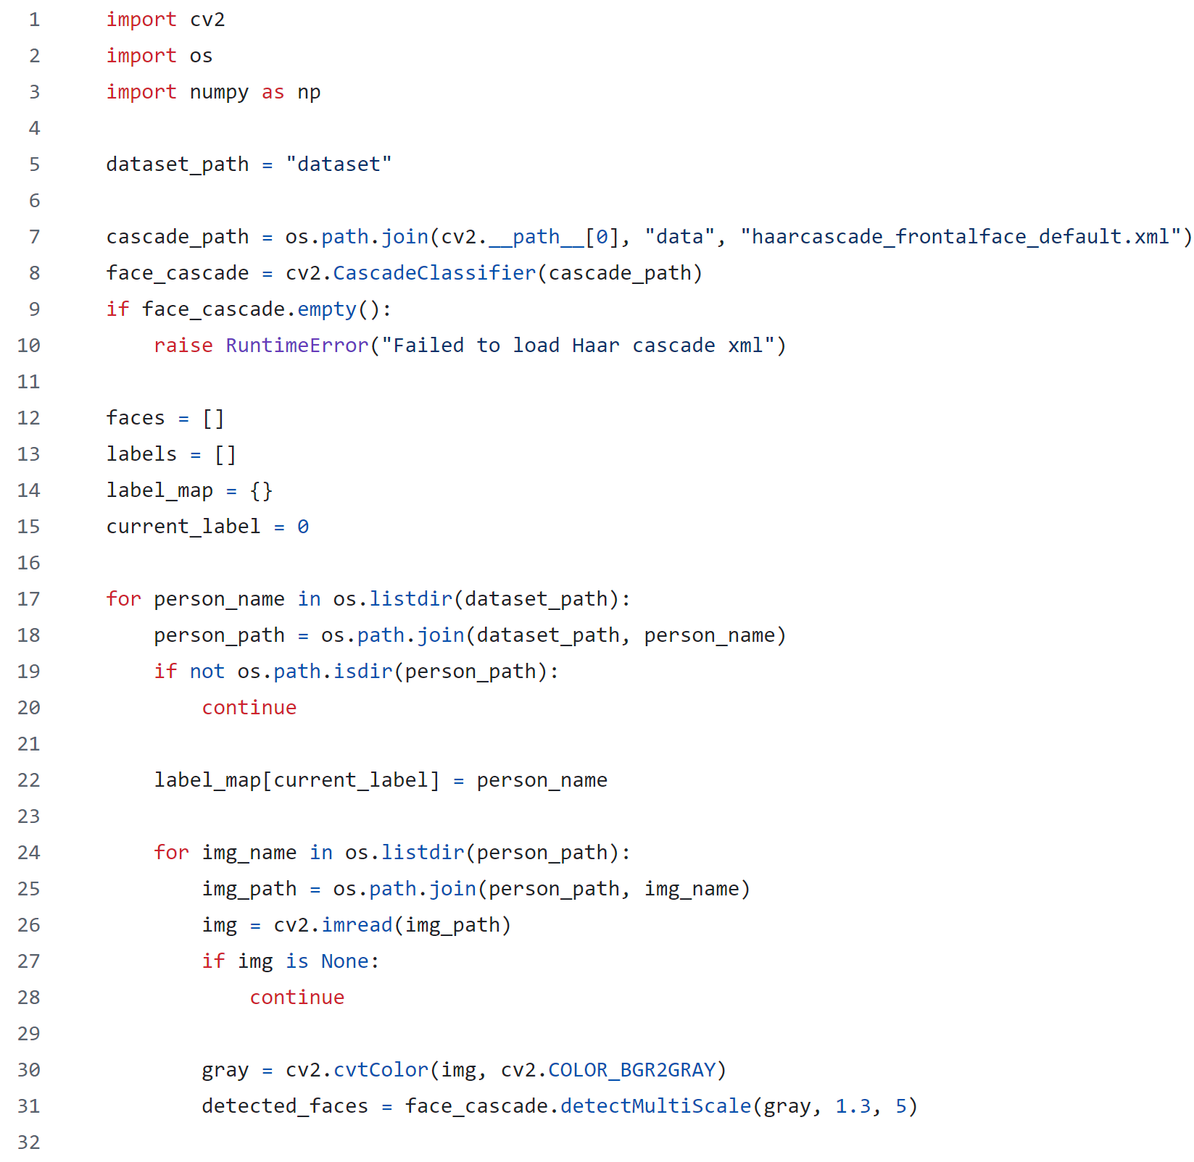
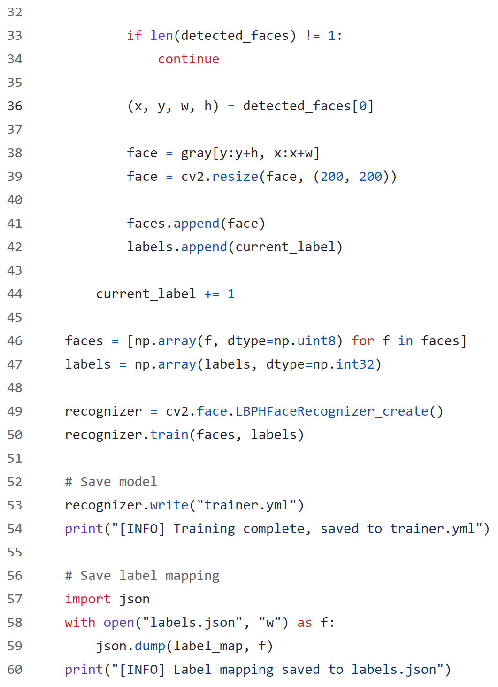
Training Facial Recognition for Whitelist

Slide 11
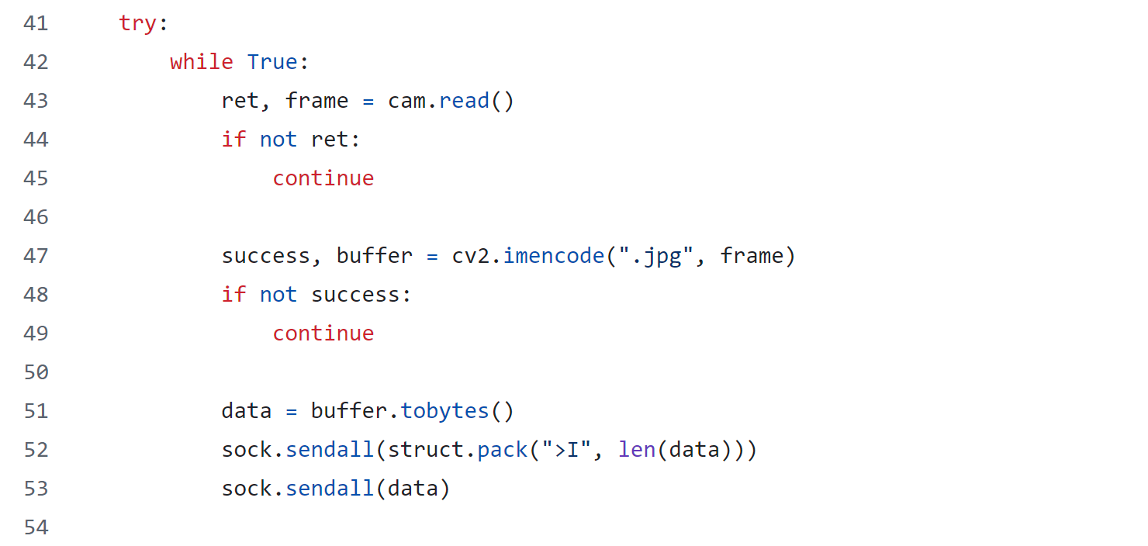
Open CV on Pi → Sends Data to VM

Slide 12
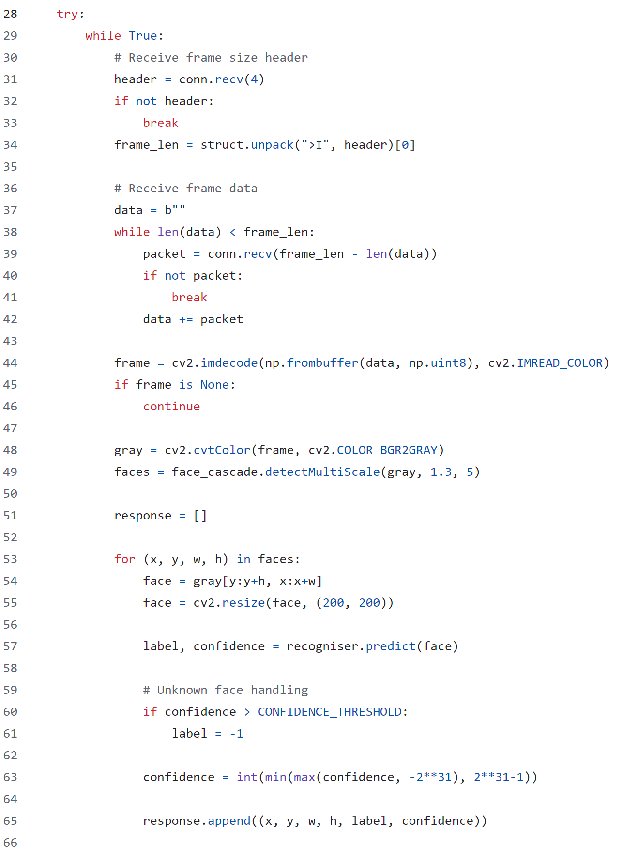
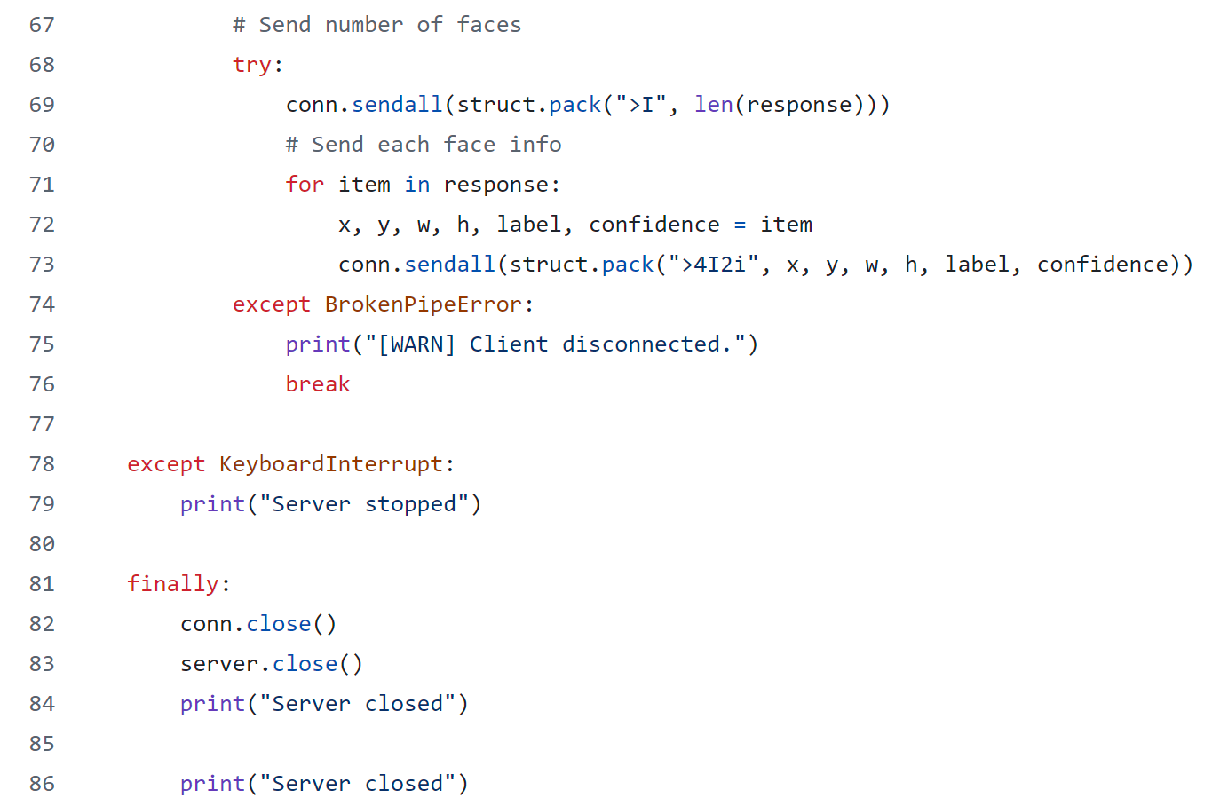
VM Checks Footage (Facial Recognition)

Slide 13
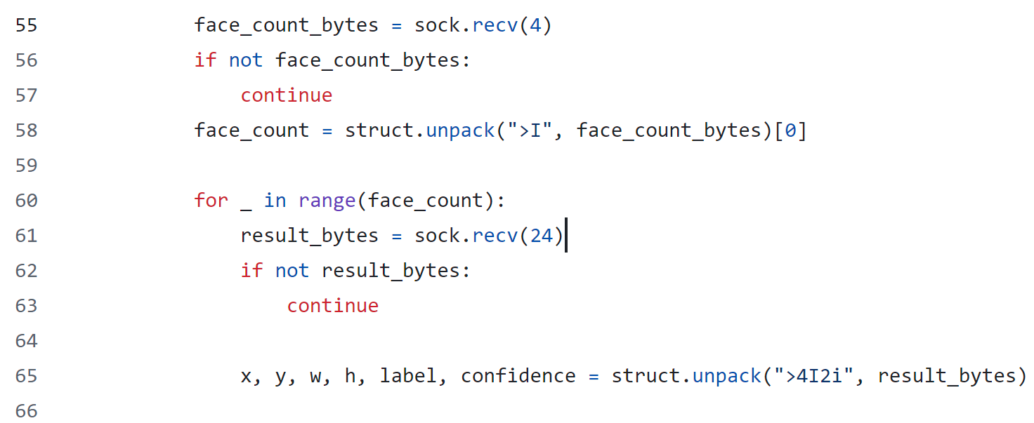
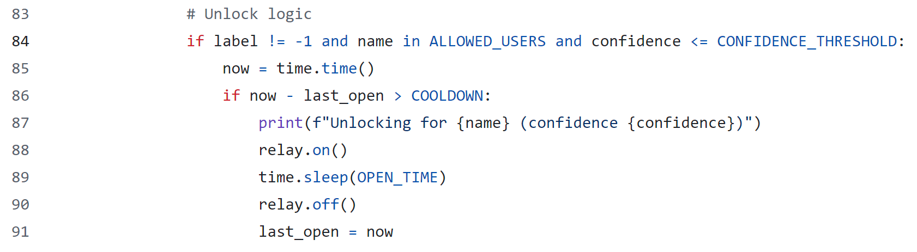
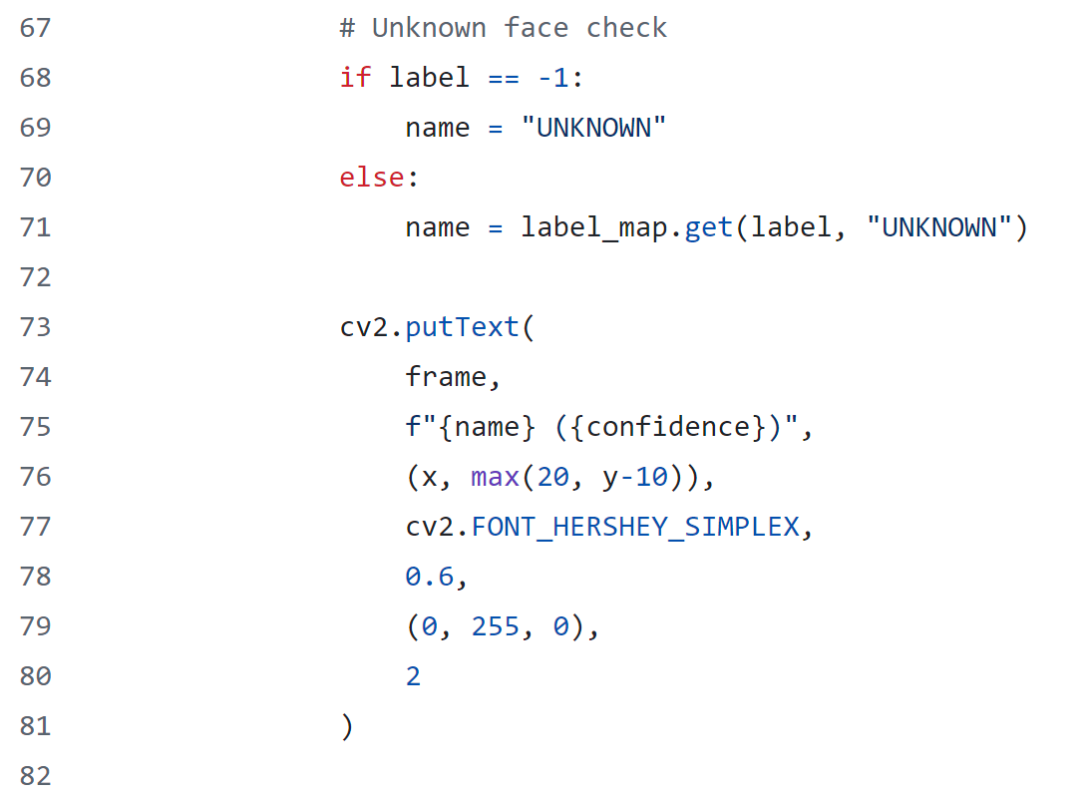
Pi Performs Logic on Footage Results

Slide 14
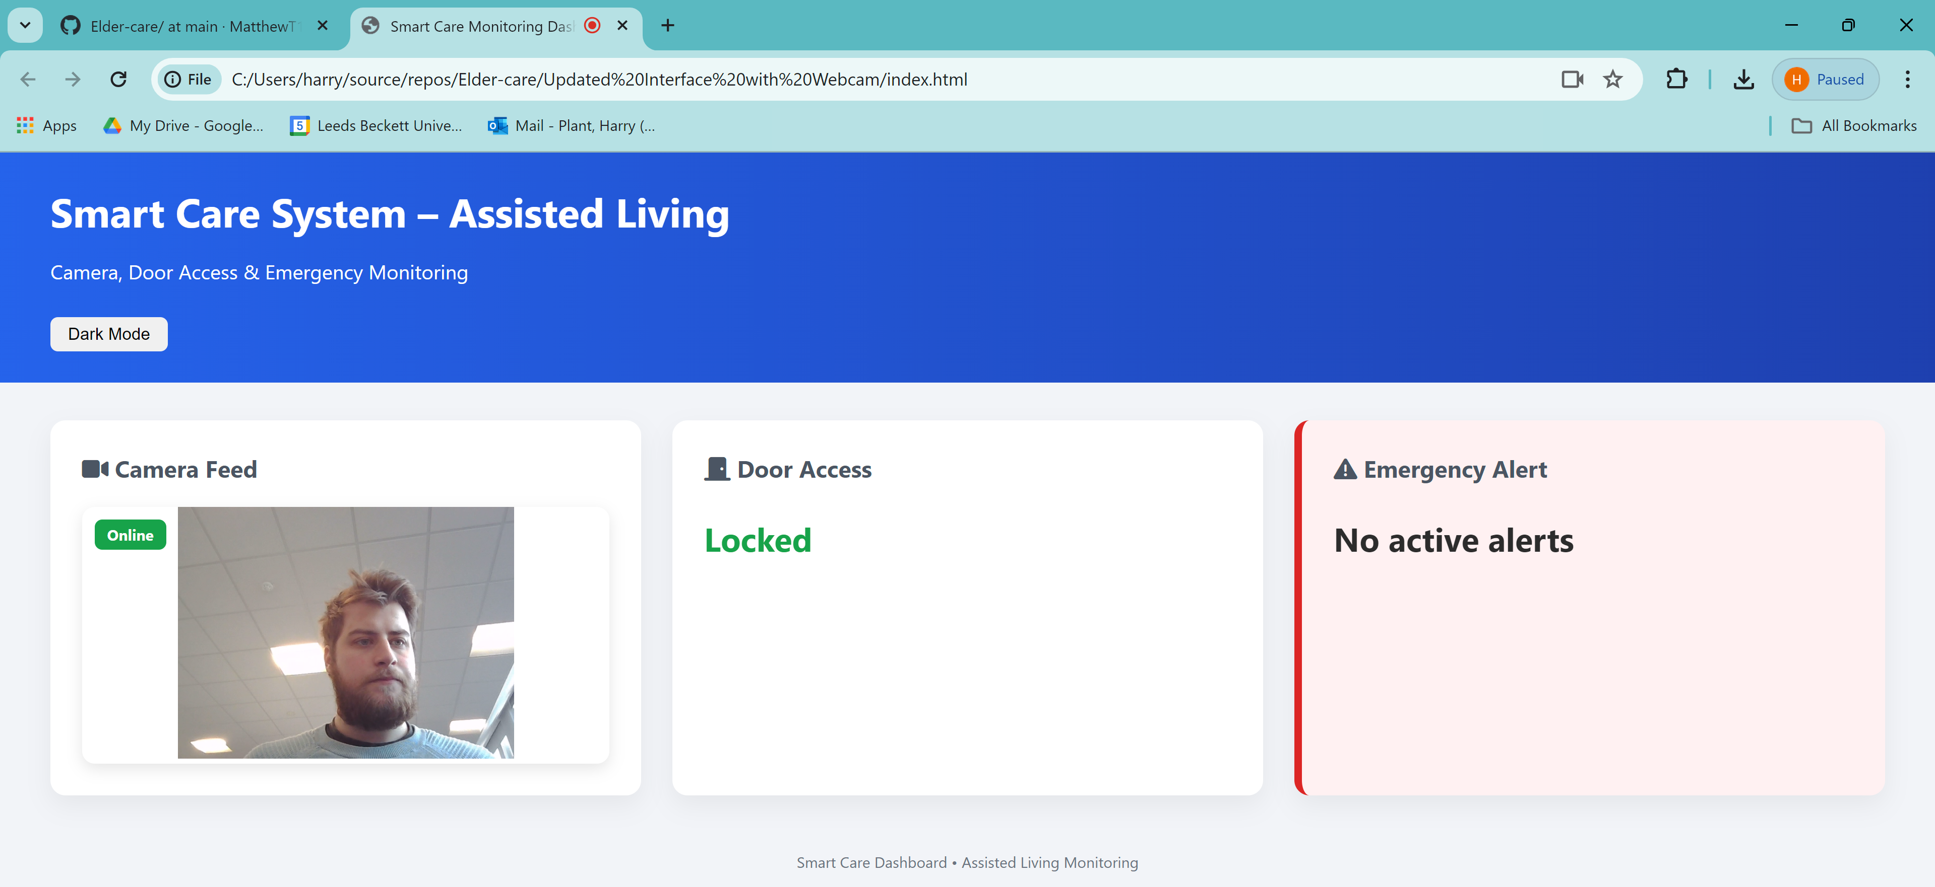
Web Interface for Client Side

Slide 15
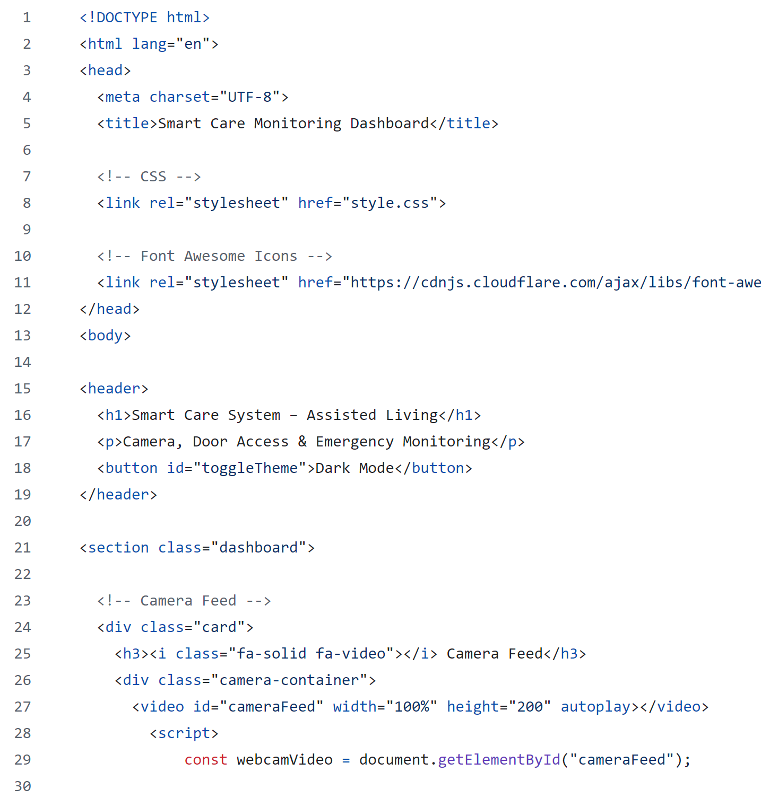
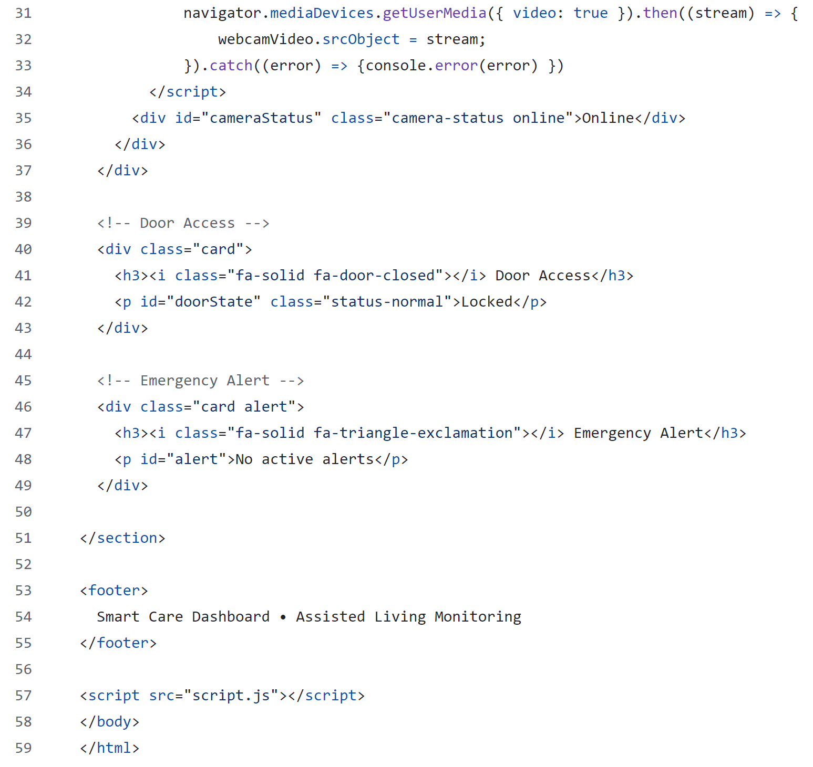

Slide 16
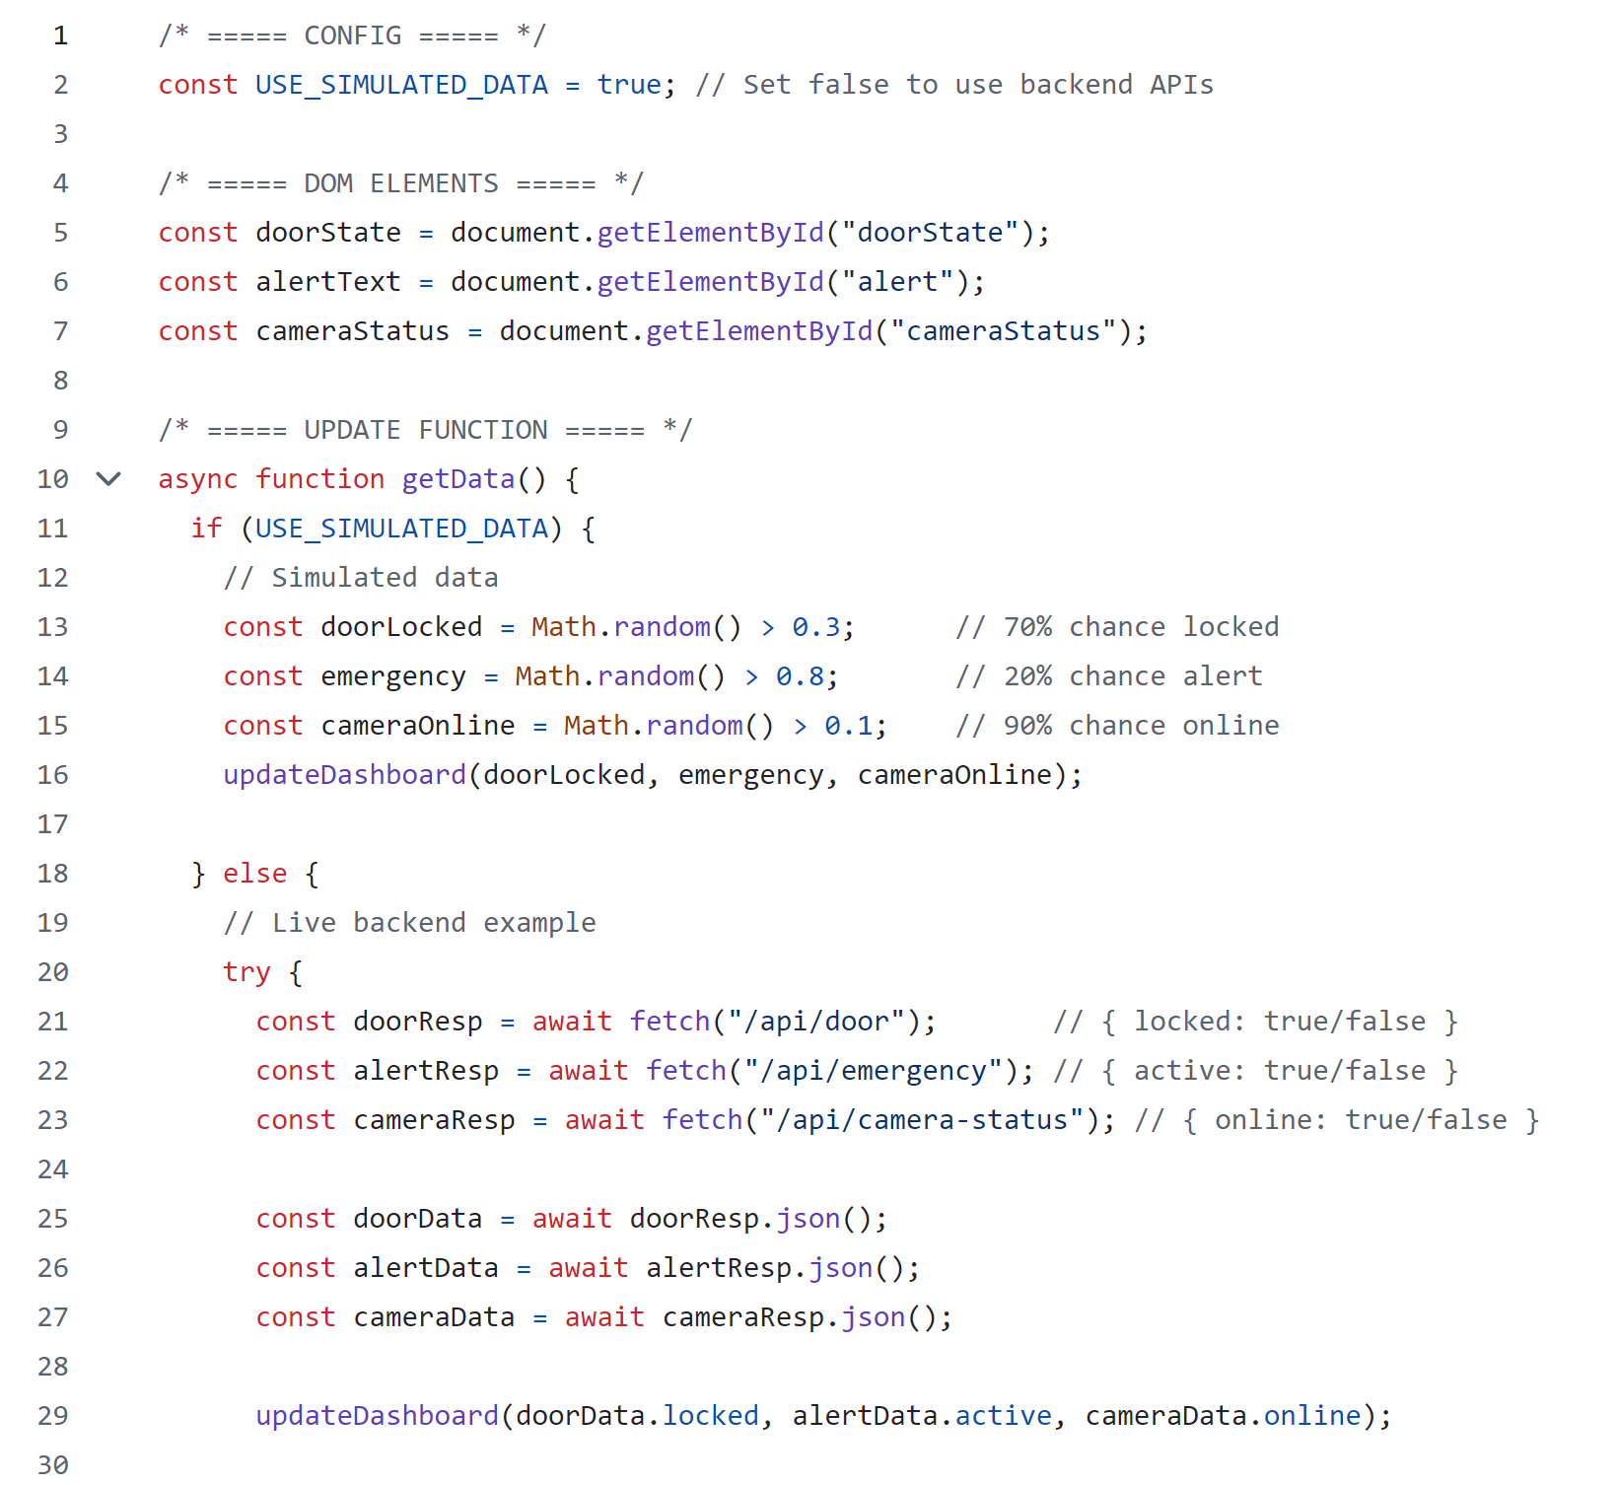
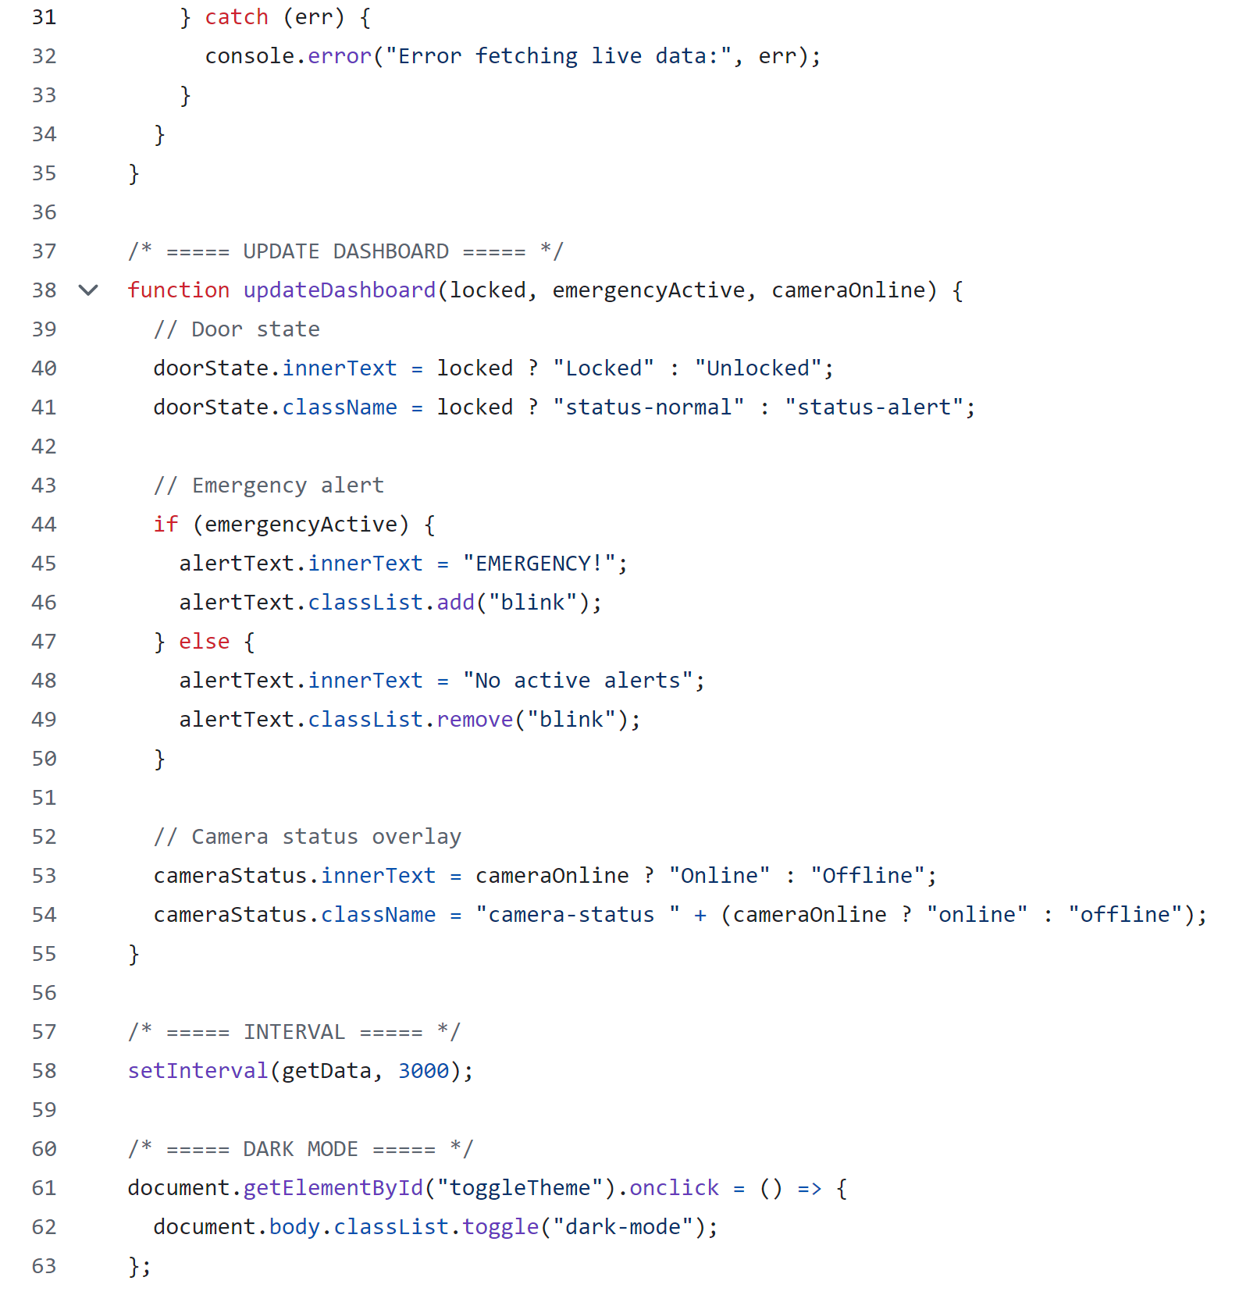

Slide 17
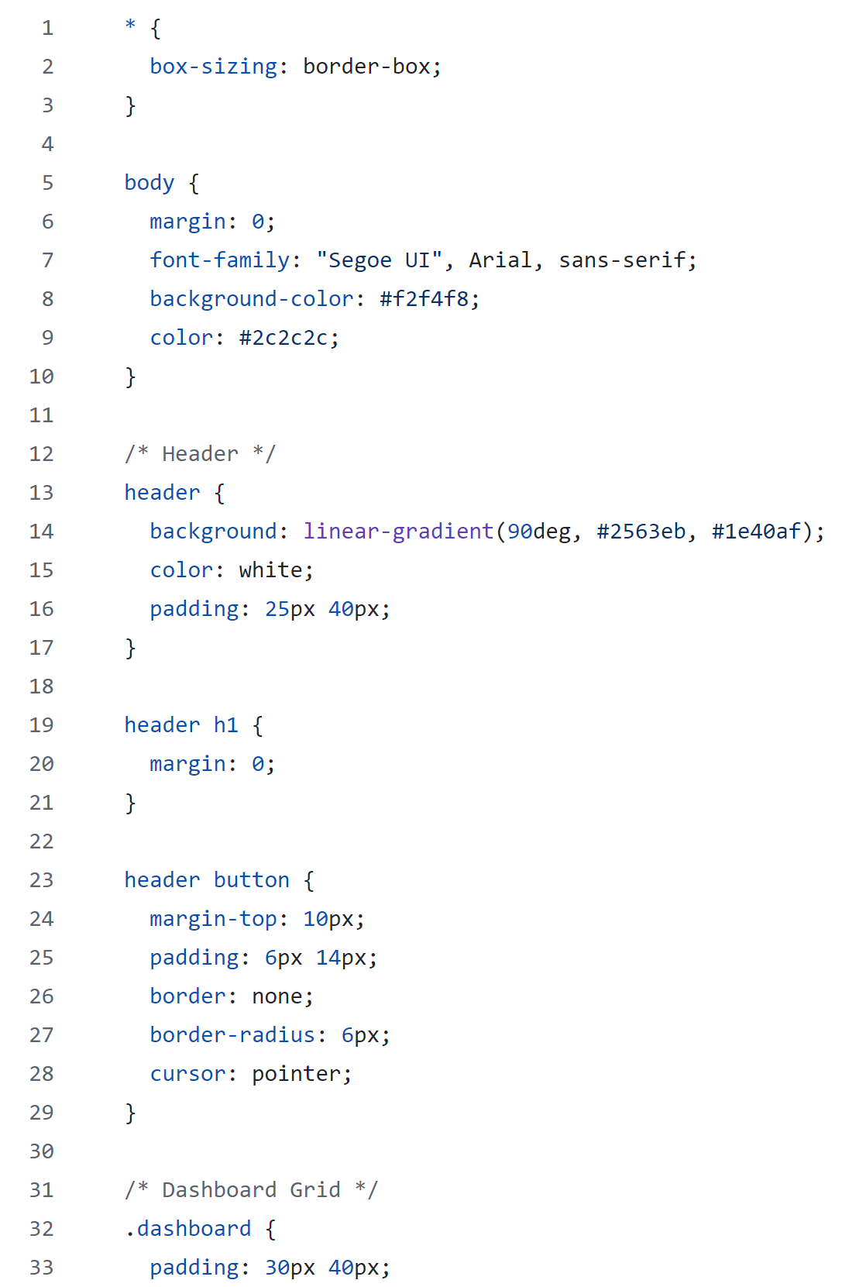
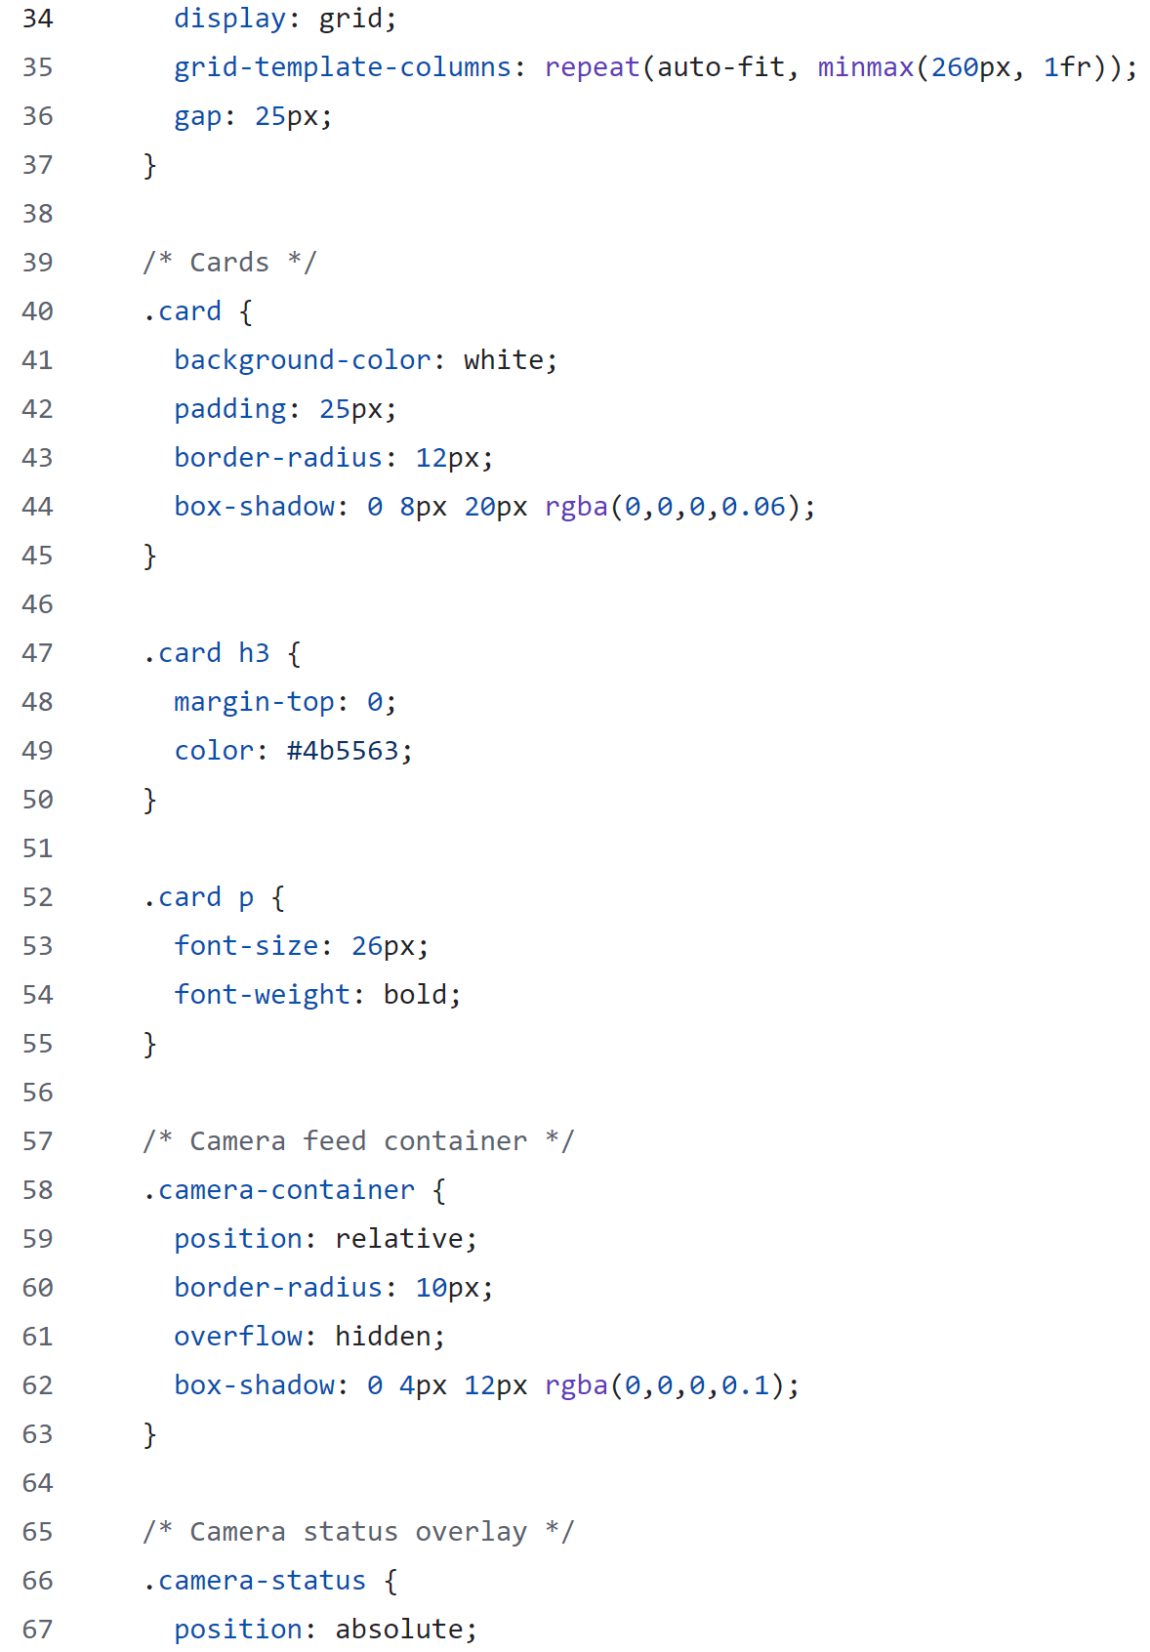
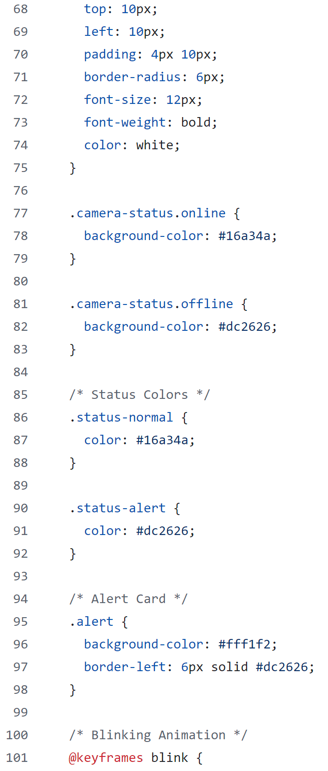

Slide 18
What Issues Have We Fixed?
The project enhances patient care within care facilities by reducing human error and increasing monitoring efficiency while providing actionable insights for caregivers to enable a better quality of life.
- Enhance system reliability and responsiveness for real-time event detection.
- Identify and addressed inefficiencies in current assisted living environments and their monitoring systems.
- Reduce false alarms and improve accuracy in detecting meaningful events.
- Ensure data privacy and security through controlled network management.
Most care homes rely on staff to produce feedback on patients; our solution begins to remove human error to monitor patients continuously, allowing for immediate intervention if necessary.

Slide 19
Future Deployments
Change of Services
Further functions & services can be implemented relatively easily
Change of Environment
Nature of system can be used with little to no modification in alternative environments.
Easily Expandable
Subsequent clients and sister systems could be implemented to cover multiple locations etc.

Slide 20
Conclusion
We have created a system which can detect events such as a human falling over allowing for quicker response times to incidents.
It runs locally on a raspberry pi and interface with a cloud to have a lot more computing power than a pi can offer
Furthermore, it will be able to be adapted to other environments than just elderly care as it runs on open-source library’s where possible, allowing easy access with paywalls for users.

Slide 21
Any Questions?

